Slide 1
IP Addresses
Classful Addressing

Slide 2
An IP address is a 32-bit address.
The IP addresses are unique.

Slide 3
Address Space
…………..
…………..
addr1
addr15
addr2
…………..
…………..
…………..
addr41
addr226
addr31
…………..
…………..

Slide 4
RULE:
If a protocol uses N bits to define an address, the address space is 2^{N}
because each bit can have two different values (0 and 1) and N bits can have 2^{N} values.
The address space of IPv4 is 2³² or
4,294,967,296
…………..
addr1
addr15
addr2
…………..
…………..
…………..
addr41
addr226
addr31
…………..
…………..

Slide 5
Binary Notation
01110101 10010101 00011101 11101010

Slide 6
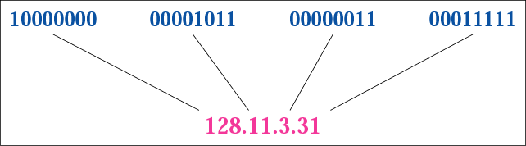
Dotted-decimal notation

Slide 7
Hexadecimal Notation
0111 0101 1001 0101 0001 1101 1110 1010
75 95 1D EA
75951DEA

Slide 8
Hexadecimal | Decimal | Binary tree
0 | 0 | 0000
1 | 1 | 0001
2 | 2 | 0010
3 | 3 | 0011
4 | 4 | 0100
5 | 5 | 0101
6 | 6 | 0110
7 | 7 | 0111
8 | 8 | 1000
9 | 9 | 1001
A | 10 | 1010
B | 11 | 1011
C | 12 | 1100
D | 14 | 1101
E | 15 | 1110
F | 16 | 1111

Slide 9
Example 1
Change the following IP address from binary notation to dotted-decimal notation.
10000001 00001011 00001011 11101111
Solution
129.11.11.239

Slide 10
Example 2
Change the following IP address from dotted-decimal notation to binary notation.
111.56.45.78
Solution
01101111 00111000 00101101 01001110

Slide 11
Example 3
Find the error, if any, in the following IP address:
111.56.045.78
Solution
There are no leading zeroes in
dotted-decimal notation (045).

Slide 12
Example 3 (continued)
Find the error, if any, in the following IP address:
75.45.301.14
Solution
In dotted-decimal notation, each number is
less than or equal to 255; 301 is outside
this range.

Slide 13
Example 4
Change the following IP addresses from binary notation to hexadecimal notation.
10000001 00001011 00001011 11101111
Solution
0X810B0BEF or 810B0BEF₁₆

Slide 14
CLASSFUL
ADDRESSING

Slide 15
IP Addressess
IP is a network layer - it must be capable of providing communication between hosts on different kinds of networks (different data-link implementations).
The address must include information about what network the receiving host is on. This is what makes routing feasible.
Includes a network ID and a host ID.
Every host must have a unique IP address.

Slide 16
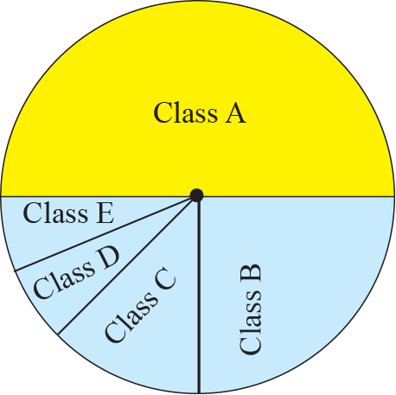
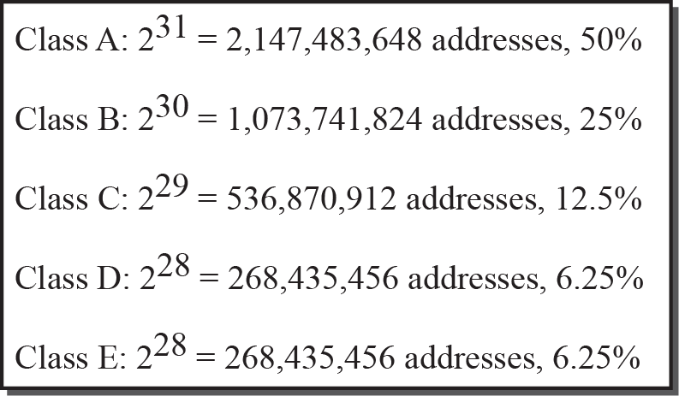
Occupation of the address space
2³¹(50%)
2²⁹(12.5%)
2²⁸(6.25%)

Slide 17

In classful addressing,
the address space is
divided into five classes:
A, B, C, D, and E.

Slide 18

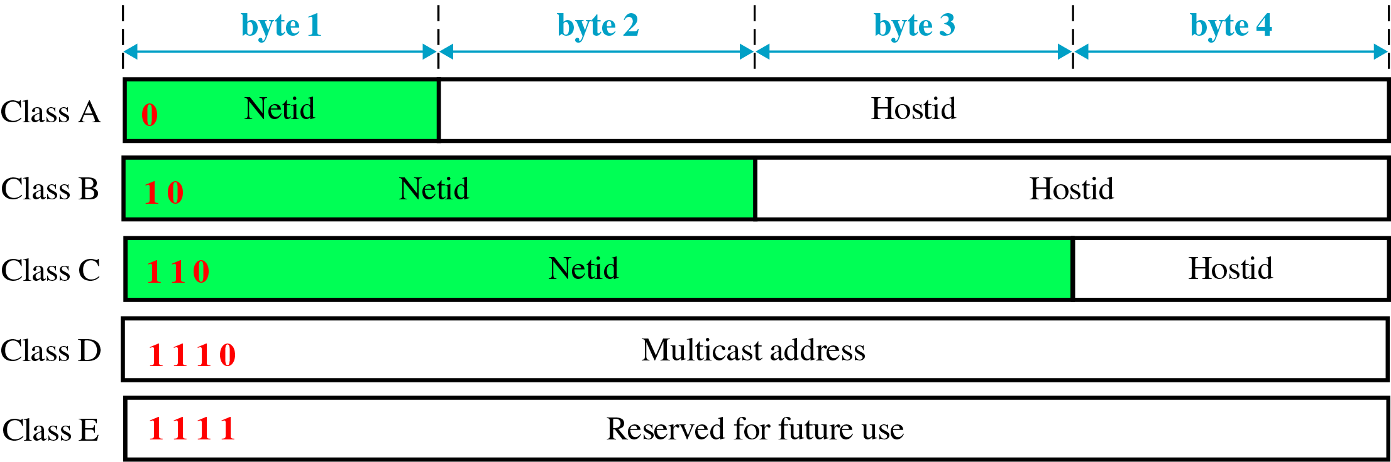
Classful IP Address

Slide 19
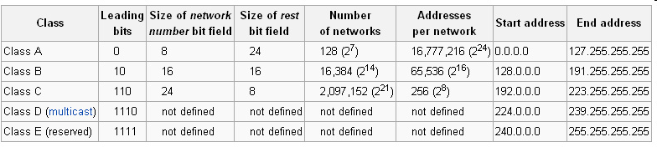

Slide 20
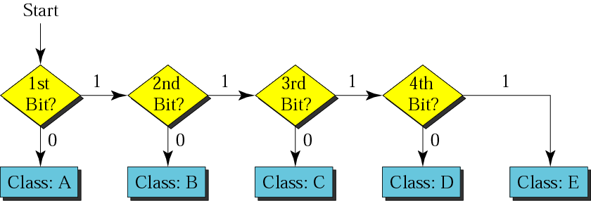
Finding the address class

Slide 21
The four formats of IP Addresses
Class
A
0
NetID
HostID
B
10
NetID
HostID
C
110
NetID
HostID
D
1110
Multicast Address
8 bits
8 bits
8 bits
8 bits

Slide 22
Example 1
Find the class of each address.
a. 00000001 00001011 00001011 11101111
b. 11000001 10000011 00011011 11111111
c. 14.23.120.8
d. 252.5.15.111

Slide 23
Solution
a. The first bit is 0. This is a class A address.
b. The first 2 bits are 1; the third bit is 0. This is a class C address.
c. The first byte is 14; the class is A.
d. The first byte is 252; the class is E.

Slide 24
Network and Host IDs
A Network ID is assigned to an organization by a global authority.
Host IDs are assigned locally by a system administrator.
Both the Network ID and the Host ID are used for routing.

Slide 25
IP Addresses
IP Addresses are usually shown in dotted decimal notation:
1.2.3.4 00000001 00000010 00000011 00000100
cs.rpi.edu is 128.213.1.1
10000000 11010101 00000001 00000001
CS has a class B network

Slide 26
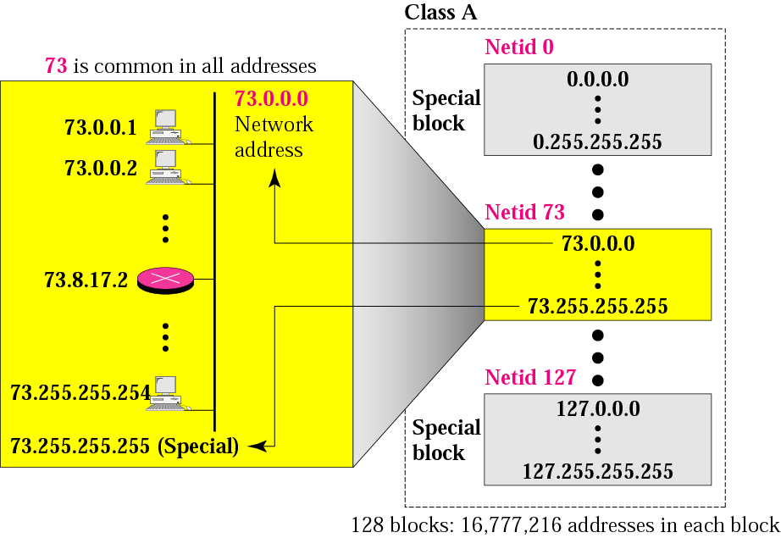
Blocks in class A

Slide 27
Millions of class A addresses
are wasted.

Slide 28
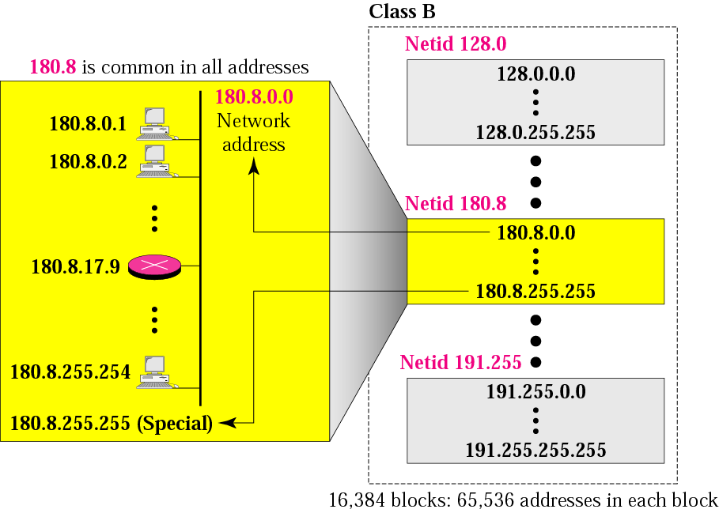
Blocks in class B

Slide 29
Many class B addresses
are wasted.

Slide 30
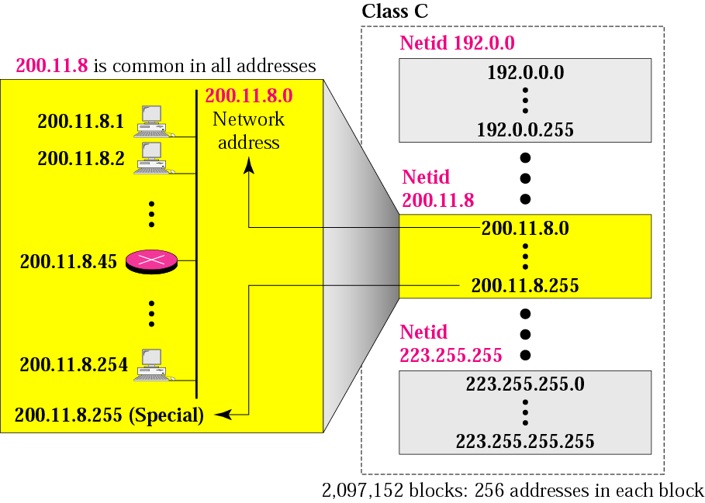
Blocks in class C

Slide 31
The number of addresses in
a class C block
is smaller than
the needs of most organizations.

Slide 32
Class D addresses
are used for multicasting;
there is only
one block in this class.

Slide 33
Class E addresses are reserved
for special purposes;
most of the block is wasted.

Slide 34
Network Addresses
The network address is the first address.
The network address defines the network to the rest of the Internet.
Given the network address, we can find the class of the address, the block, and the range of the addresses in the block

Slide 35
In classful addressing,
the network address
(the first address in the block)
is the one that is assigned
to the organization.

Slide 36
Example 9
Given the network address 17.0.0.0, find the class, the block, and the range of the addresses.
Solution
The class is A because the first byte is between
0 and 127. The block has a netid of 17.
The addresses range from 17.0.0.0 to
17.255.255.255.

Slide 37
Example 10
Given the network address 132.21.0.0, find the class, the block, and the range of the addresses.
Solution
The class is B because the first byte is between
128 and 191. The block has a netid of
132.21. The addresses range from
132.21.0.0 to 132.21.255.255.

Slide 38
Example 11
Given the network address 220.34.76.0, find the class, the block, and the range of the addresses.
Solution
The class is C because the first byte is between 192 and 223. The block has a netid of 220.34.76.The addresses range from 220.34.76.0 to 220.34.76.255.

Slide 39
Mask
A mask is a 32-bit number in which the n leftmost bits are Is and the 32 - n rightmost bits are Os.
However, in classless addressing the mask for a block can take any value from 0 to 32. It is very convenient to give just the value of n preceded by a slash (CIDR notation).
In 1Pv4 addressing, a block of addresses can be defined as x.y.z.t/n in which x.y.z.t defines one of the addresses and the /n defines the mask.

Slide 40
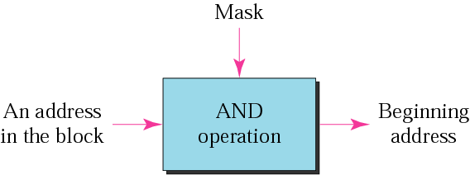
Masking concept

Slide 41
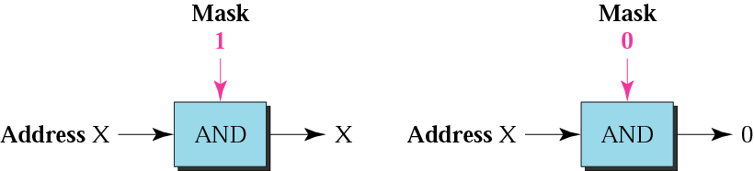
AND operation

Slide 42
The network address is the
beginning address of each block.
It can be found by applying
the default mask to
any of the addresses in the block
(including itself).
It retains the netid of the block
and sets the hostid to zero.

Slide 43

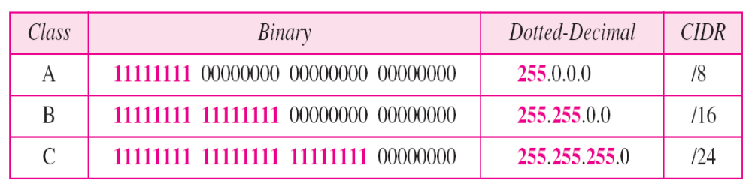
Number of blocks and block size in classful IPv4 addressing
Default masks for classful addressing

Slide 44
Example 12
Given the address 23.56.7.91/8, find the beginning address (network address).
Solution
The default mask is 255.0.0.0, which means
that only the first byte is preserved and the
other 3 bytes are set to 0s. The network
address is 23.0.0.0.

Slide 45
Example 13
Given the address 132.6.17.85/16 and, find the beginning address (network address).
Solution
The default mask is 255.255.0.0, which
Means that the first 2 bytes are preserved
and the other 2 bytes are set to 0s. The
network address is 132.6.0.0.

Slide 46
Example 14
Given the address 201.180.56.5/24, find the beginning address (network address).
Solution
The default mask is 255.255.255.0,
which means that the first 3 bytes are
preserved and the last byte is set to 0.
The network address is 201.180.56.0.

Slide 47
We must not
apply the default mask
of one class to
an address belonging
to another class.

Slide 48
CIDR (Classless Inter-Domain Routing) Notation
18.46.74.10/8 – Class A
141.24.74.69/16 - Class B
200.14.70.22/24 – Class C
Number of 1’s in the mask

Slide 49
SUBNETTING

Slide 50
IP addresses are designed with
two levels of hierarchy.

Slide 51
Subnet Addresses
An organization can subdivide it’s host address space into groups called subnets.
The subnet ID is generally used to group hosts based on the physical network topology.
10
NetID
SubnetID
HostID

Slide 52

Hierarchy concept in a telephone number
Two levels: Netid & Hostid
Three levels: Netid : subnetid : Hostid

Slide 53
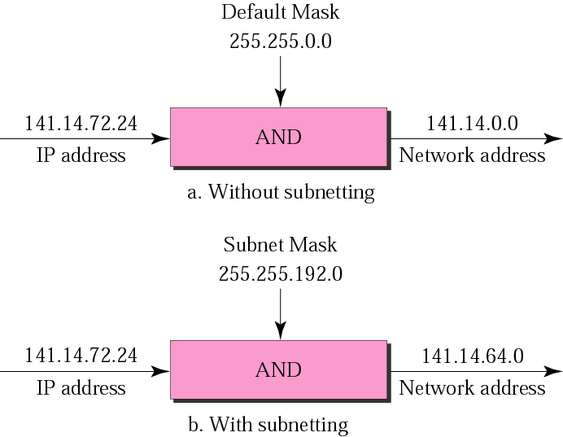
Default mask and subnet mask

Slide 54
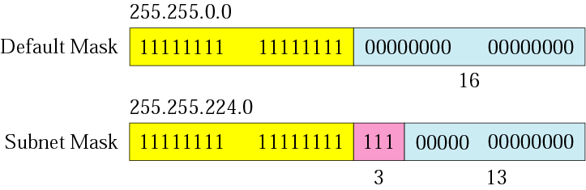
Comparison of a default mask and
a subnet mask

Slide 55
Finding the Subnet Address
Given an IP address, we can find the subnet address the same way we found the network address. We apply the mask to the address. We can do this in two ways: straight or short-cut.

Slide 56
Straight Method
In the straight method, we use binary notation for both the address and the mask and then apply the AND operation to find the subnet address.

Slide 57
Example 15
What is the subnetwork address if the destination address is 190.45.34.56 and the subnet mask is 255.255.240.0?

Slide 58
Solution
10111110 00101101 00100010 00111000
11111111 11111111 11110000 00000000
11001000 00101101 00100000 00000000
The subnetwork address is 190.45.32.0.

Slide 59
Short-Cut Method
    ** If the byte in the mask is 255, copy the byte in the address.
    ** If the byte in the mask is 0, replace the byte in the address with 0.
    ** If the byte in the mask is neither 255 nor 0, we write the mask and the address in binary and apply the AND operation.

Slide 60
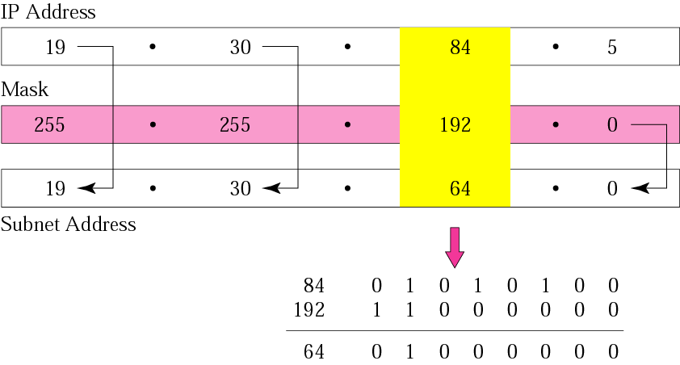
What is the subnetwork address if the destination address is 19.30.84.5 and the mask is 255.255.192.0?

Slide 61
The number of subnets must be
a power of 2.

Slide 62
A company is granted the site address 201.70.64.0 . The company needs six subnets. Design the subnets.
Solution
The number of 1s in the default
mask is 24 (class C).

Slide 63
Solution (Continued)
The company needs six subnets. This number 6 is not a power of 2. The next number that is a power of 2 is 8 (2³). We need 3 more 1s in the subnet mask.
The total number of 1s in the subnet mask is 27 (24 + 3).
The total number of 0s is 5 (32 − 27).

Slide 64
Solution (Continued)
The mask is
11111111 11111111 11111111 11100000
or
255.255.255.224
    The number of subnets is 8.
    The number of addresses in each subnet is 2⁵ (5 is the number of 0s) or 32.

Slide 65
A company is granted the site address 181.56.0.0 . The company needs 1000 subnets. Design the subnets.
Solution
The number of 1s in the default mask is 16 (class B).

Slide 66
Solution (Continued)
The company needs 1000 subnets. This number is not a power of 2. The next number that is a power of 2 is 1024 (2¹⁰). We need 10 more 1s in the subnet mask.
The total number of 1s in the subnet mask is 26 (16 + 10).
The total number of 0s is 6 (32 − 26).

Slide 67
Solution (Continued)
The mask is
11111111 11111111 11111111 11000000
or
255.255.255.192.
The number of subnets is 1024.
The number of addresses in each subnet is 2⁶ (6 is the number of 0s) or 64.

Slide 68
SUPERNETTING

Slide 69
Comparison
Subnetting
Supernetting
1’s are made more than the default mask
A subnet mask divides a block into subblocks [Eg. SITE, SCSE, SMBS]
1’s are made less than the default mask
A supernet combines n blocks into one superblock [ Combining several blocks]

Slide 70
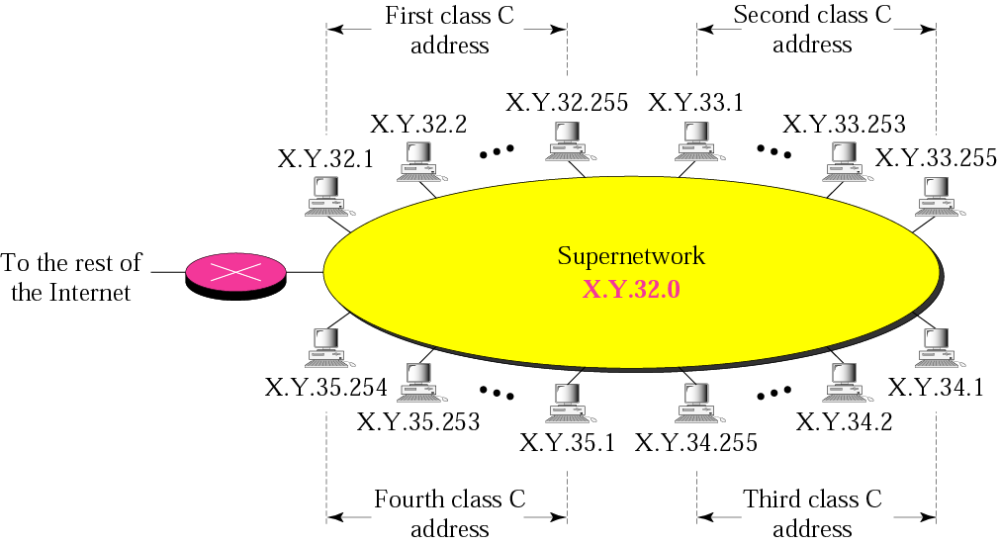
A supernetwork
Why supernetwork?
1. Class C too small
2. Routing table efficiency

Slide 71
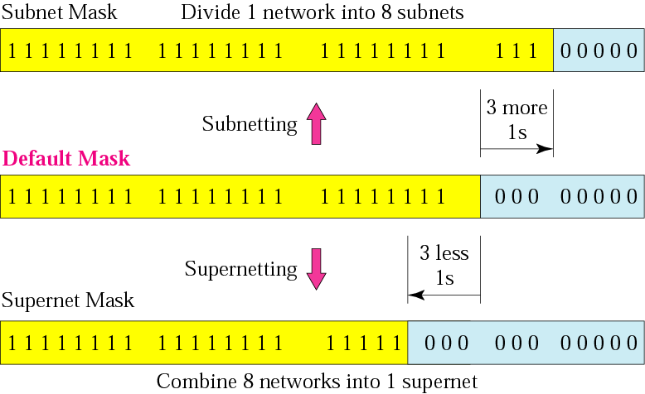
Comparison of subnet, default,
and supernet masks

Slide 72
We need to make a supernetwork out of 16 class C blocks. What is the supernet mask?
Solution
We need 16 blocks. For 16 blocks we need to change four 1s to 0s in the default mask. So the mask is
11111111 11111111 11110000 00000000
or
255.255.240.0

Slide 73
A supernet has a first address of 205.16.32.0 and a supernet mask of 255.255.248.0. A router receives three packets with the following destination addresses:
    205.16.37.44
    205.16.42.56
    205.17.33.76
Which packet belongs to the supernet?

Slide 74
Solution
We apply the supernet mask to see if we can find the beginning address.
205.16.37.44 AND 255.255.248.0 ➔  205.16.32.0
205.16.42.56 AND 255.255.248.0 ➔  205.16.40.0
205.17.33.76 AND 255.255.248.0 ➔  205.17.32.0
Only the first address belongs to this supernet.

Slide 75
A company needs 600 addresses. Which of the following set of class C blocks can be used to form a supernet for this company?
198.47.32.0 198.47.33.0 198.47.34.0
198.47.32.0 198.47.42.0 198.47.52.0 198.47.62.0
198.47.31.0 198.47.32.0 198.47.33.0 198.47.34.0
198.47.32.0 198.47.33.0 198.47.34.0 198.47.35.0

Slide 76
Solution
1: No, there are only three blocks.
2: No, the blocks are not contiguous.
3: No, 31 in the first block is not divisible by 4.
4: Yes, all three requirements are fulfilled.

Slide 77
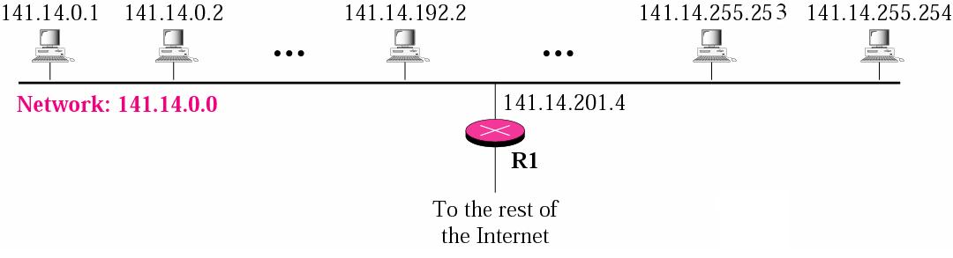
A network with two levels of
hierarchy (not subnetted)
Why subnetting?
1. The transmissions of these hosts will affect one another.
2. Class B too large, wasteful.
3. Not easy to manage. (e.g., where is host 141.14.190.1?)

Slide 78
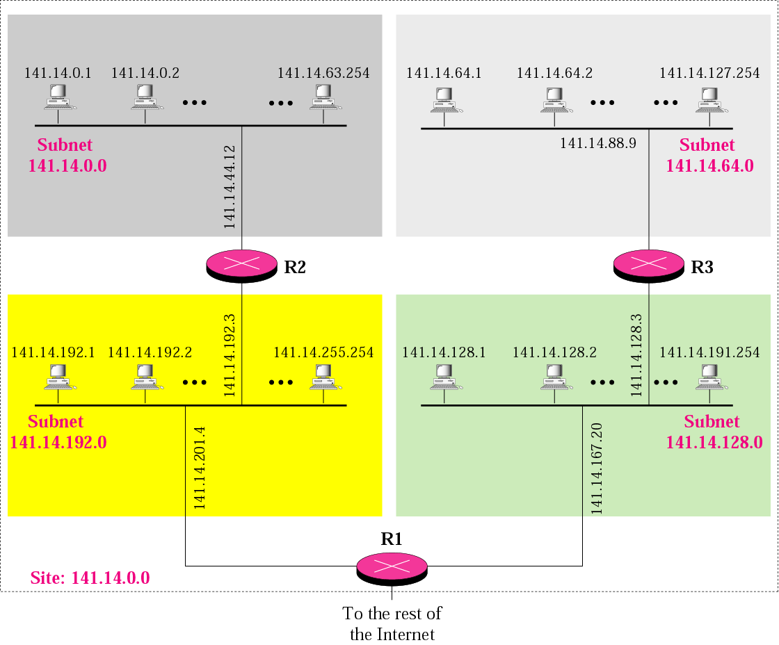
A network with three levels of
hierarchy (subnetted)

Slide 79
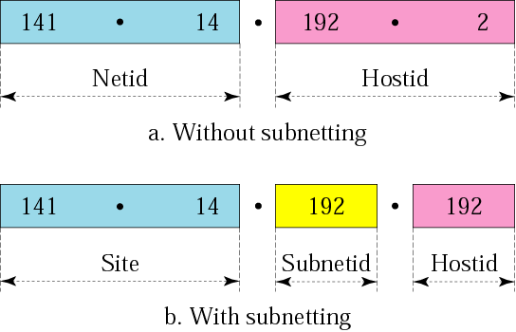
Addresses in a network with
and without subnetting

Slide 80

Note:
The idea of subnetting and supernetting of classful addresses is almost obsolete.
TCP/IP Protocol Suite

